Slide 1
Using R in Industry
R Ladies of London

Slide 2
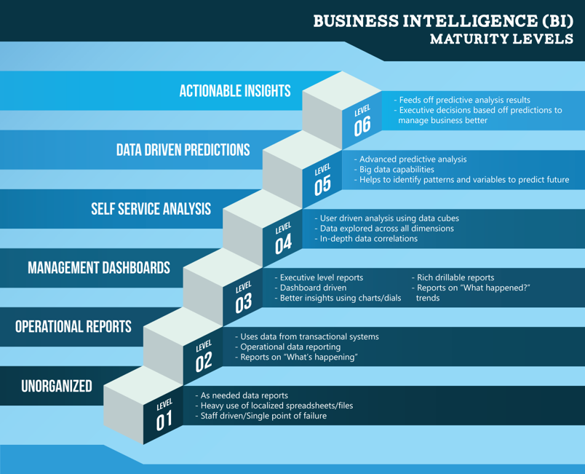
Data Intelligence
Data
Accountable!

Slide 3
My Most Used References
Cheat Sheets - https://www.rstudio.com/resources/cheatsheets/
R Cookbook – Lean Pub
R Graphics Cookbook – Lean Pub
An Introduction to Statistical Learning with Applications in R
Stack Overflow
Weapons of Math Destruction – Cathy O’Neil
Little Book of Statistical Inference – Brian Caffo Github

Slide 4
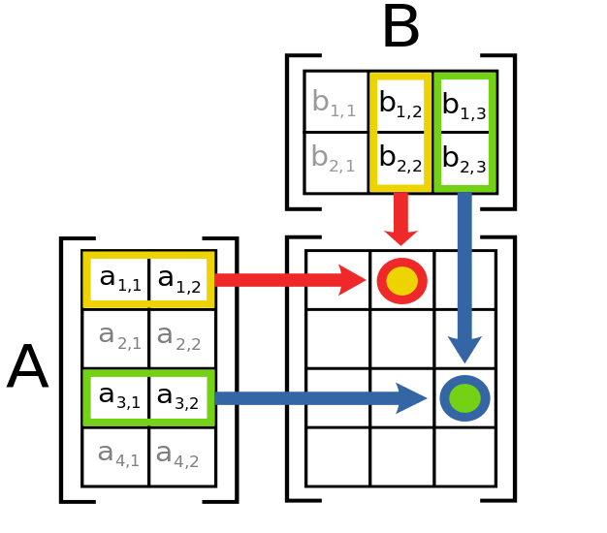
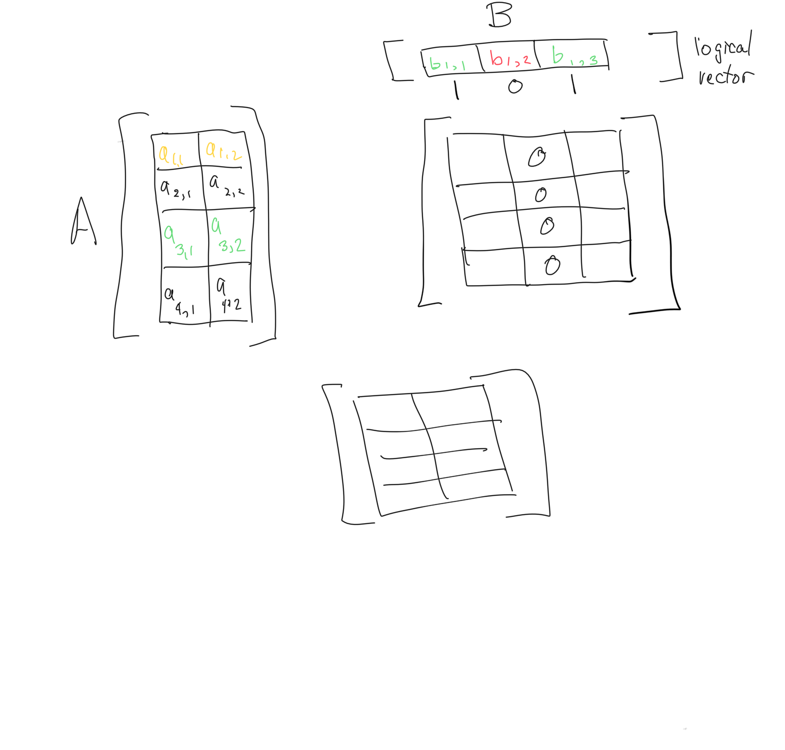
Logical Vector Theory
Multiplying with a Logical Vector
Matrix Multiplication

Slide 5
KPI’s Key Performance Indicators
Customer Retention Rate
Relative Market Share
Revenue Growth Rate
Time To Health Care Service
Lab Turnaround Time
OEE – Overall Equipment Effectiveness

Slide 6
OEE – From Wikipedia
OEE is calculated with the formula (Availability)*(Performance)*(Quality)
Using the examples given below:
(Availability= 86.6%)*(Performance=93%)*(Quality=91.3%)= (OEE=73.6%)
Alternatively, and often easier, OEE is calculated by dividing the minimum time needed to produce the parts under optimal conditions by the actual time needed to produce the parts.
For example:
Total Time: 8 hour shift or 28,800 seconds, producing 14,400 parts, or one part every 2 seconds.
Fastest possible cycle time is 1.5 seconds, hence only 21,600 seconds would have been needed to produce the 14,400 parts. The remaining 7,200 seconds or 2 hours were lost.
The OEE is now the 21,600 seconds divided by 28,800 seconds (same as minimal 1.5 seconds per part divided by 2 actual seconds per part), or 75%.

